Slide 1
Artificial Neural Network

Slide 2
Artificial Neural Networks — Mapping the Human Brain
Notes:
ANN is a very powerful , strong as well as a very complicated Machine Learning technique which mimics a human brain and how it functions.
Like our human brain has millions of neurons in a hierarchy and Network of neurons which are interconnected with each other via Axons and passes Electrical signals from one layer to another called synapses. This is how we humans learn things. Whenever we see, hear, feel and think something a synapse(electrical impulse) is fired from one neuron to another in the hierarchy which enables us to learn , remember and memorize things in our daily life since the day we were born.

Slide 3
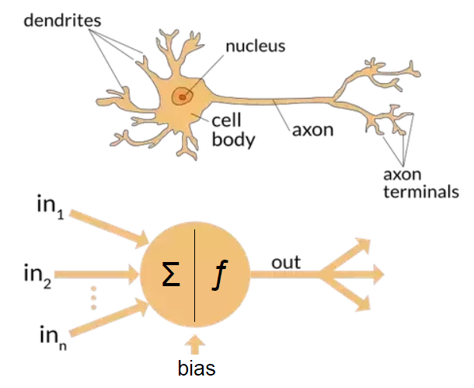
Artificial Neural Networks — Mapping the Human Brain

Slide 4
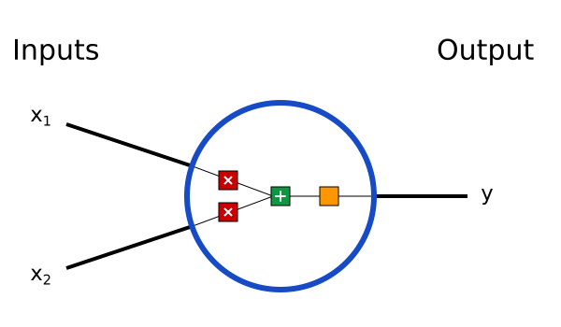
Building Blocks: Neurons
Neuron is a basic unit of neural network. A neuron takes inputs, does some math with them, and produces one output. Here’s what a 2-input neuron looks like:

Slide 5
What is happening here?
3 steps are performing here
1st step: each input is multiplied by a weight
x1 -> x1*w1
x2 -> x2*w2
2nd step: weighted inputs are added together with a bias b
(x1*w1)+(x2*w2)+b
3rd step: Finally, the sum is passed through an activation function
y=f((x1*w1)+(x2*w2)+b)

Slide 6
What are weights(parameters)?
A weight brings down the importance of the input value.
Weights near zero means changing this input will not change the output.
Negative weights mean increasing this input will decrease the output.
A weight decides how much influence the input will have on the output.

Slide 7
Understanding weights(parameters) with a simple example:
Say you want to decide whether you are going to attend a festival this upcoming weekend. There are three variables that go into your decision:
Is the weather good?
Does your friend want to go with you?
Is it near public transportation?
Write the answers to these question as binary variables xi , with zero being the answer ‘no’ and one being the answer ‘yes’:
Is the weather good? x1
Does your friend want to go with you? x2
Is it near public transportation? x3
We could determine weights w_{i} indicating how important each feature is to whether you would like to attend. We can then see if:
x1 · w1 + x2 · w2 + x3 · w3 ≥ threshold
For some pre-determined threshold. If this statement is true, we would attend the festival, and otherwise we would not.
For example, if we really hated bad weather but care less about going with our friend and public transit, we could pick the weights 6, 2 and 2.
With a threshold of 5, this causes us to go if and only if the weather is good.

Slide 8
What is bias?
Bias is one of the important terminologies in machine learning. We add bias while creating any model in the artificial neural network.
It is an extra input to neurons, and has it’s own connection weight.
Bias is a constant which helps the model in a way that it can fit best for the given data.

Slide 9
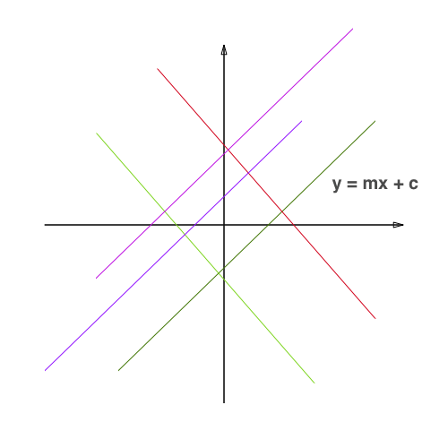
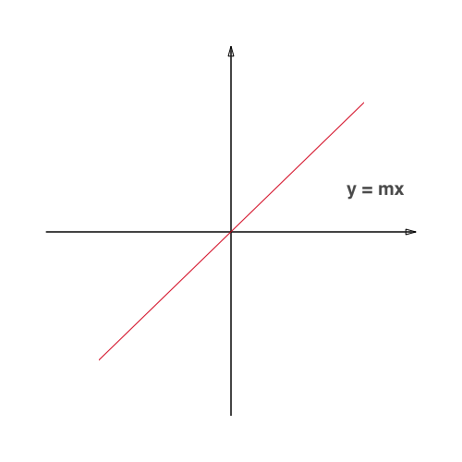
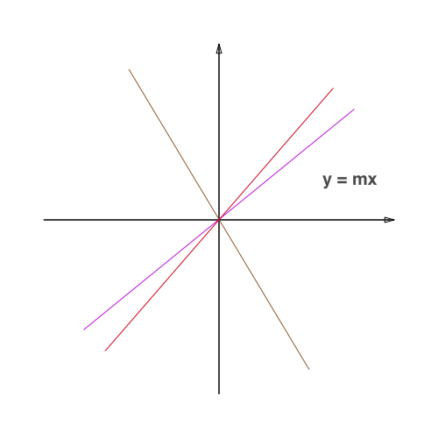
Understanding bias in simple words
In the neural network, we are given the input (x) and for that input, we need to predict the output (y). Here, we create a model (mx+c), which predicts the output.
While training, the model itself finds the appropriate value of the constants m and c.
Let's say we have the models as y=mx and y=mx+c, so what is the difference between them?
Now, it is having the full freedom to train itself and find a model which fits the best for the given data.
Here, the constant c, is the bias.
Bias is a constant which helps the model in a way that it can fit best for the given data.
Here, the model is having constraint to train itself and find a line which passes only through the origin.
Many times for the given data, it is impossible for the algorithm to fit the model so that it passes through the origin.

Slide 10
What is activation function?
What function to use to go from x · w + b to an output is called the activation function.
It is used to get the output of node. It is also known as Transfer Function.
It is used to determine the output of neural network like yes or no. It maps the resulting values in between 0 to 1 or -1 to 1 etc. (depending upon the function).

Slide 11
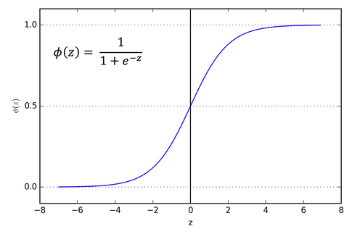
What is sigmoid activation function?
It is also called logistic activation function.
The sigmoid function curve looks like a S-shape.
It exists between (0 to 1).
It is especially used for models where we have to predict the probability as an output. Since probability of anything exists only between the range of 0 and 1, sigmoid is the right choice.

Slide 12
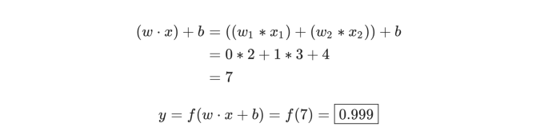
A Simple Example
Assume we have a 2-input neuron that uses the sigmoid activation function and has the following parameters:
w=[0, 1] and b=4
w=[0, 1] is just a way of writing w1​=0, w2​=1 in vector form.
Now, let’s give the neuron an input of x=[2, 3]. We’ll use the dot product :
The neuron outputs 0.999 given the inputs x=[2,3]. That’s it! This process of passing inputs forward to get an output is known as feedforward.

Slide 13
Coding a Neuron
Time to implement a neuron! We’ll use NumPy, a popular and powerful computing library for Python, to help us do math:
 | import numpy as np
 | def sigmoid(x):
 | # Our activation function: f(x) = 1 / (1 + e^(-x))
 | return 1 / (1 + np.exp(-x))
 | class Neuron:
 | def __init__(self, weights, bias):
 | self.weights = weights
 | self.bias = bias
 | def feedforward(self, inputs):
 | # Weight inputs, add bias, then use the activation function
 | total = np.dot(self.weights, inputs) + self.bias
 | return sigmoid(total)
 | weights = np.array([0, 1]) # w1 = 0, w2 = 1
 | bias = 4 # b = 0
 | n = Neuron(weights, bias)
 | x = np.array([2, 3]) # x1 = 2, x2 = 3
 | print(n.feedforward(x)) # 0.9990889488055994

